Slide 1
🎬 Movie Ratings Dashboard
Visualizing ratings and top performers by genre
Presented by: Rupam kumari
Date :1/08/2025
Indian Institute of Technology, Patna

Slide 2
📌 Problem Statement
🎯 Objective:
Visualize movie ratings to identify top performers by genre.
Expected Outcomes:
Table: Movie name & rating
Bar Chart: Avg. rating per genre
Pie Chart: Movie count by genre
List: Top 5 highest-rated movies

Slide 3
📥: Dataset Overview
🗂️Dataset Fields:
MovieID
Title
Genre
Rating
Reviews
Purpose:
Supports rating and genre-based analysis for improved recommendations.

Slide 4
📊 Movies Table
📄Sample Table (Movie name & rating):
Title | Genre | Rating
Inception | Sci-Fi | 8.8
The Godfather | Crime | 9.2
Interstellar | Sci-Fi | 8.6
Titanic | Romance | 7.8
The Dark Knight | Action | 9.0

Slide 5
📈Average Rating per Genre (Bar Chart)
🎯 Bar Chart:
Display average rating for each genre.
(Add a bar chart with genres on x-axis, average rating on y-axis)
Genre | Avg. Rating
Sci-Fi | 8.7
Crime | 9.0
Romance | 7.8
Action | 8.5

Slide 6
🥧 Slide 6: Movie Count by Genre (Pie Chart)
🔢Pie Chart:
Show proportion of movies in each genre.
(Visualize with sample proportions, e.g.:).
Genre | Count
Sci-Fi | 25
Crime | 18
Romance | 20
Action | 27

Slide 7
🏆Slide 7: Top 5 Highest-Rated Movies
Rank | Title | Genre | Rating
1 | The Godfather | Crime | 9.2
2 | The Dark Knight | Action | 9.0
3 | Inception | Sci-Fi | 8.8
4 | Interstellar | Sci-Fi | 8.6
5 | Parasite | Thriller | 8.6

Slide 8
🛠️Insights & Conclusions
Crime and Action genres have highest average ratings.
Sci-Fi is well-represented by highly-rated movies.
Top movies span many genres – appealing to diverse audiences.
Dashboard can guide recommendation engines and content curation

Slide 9
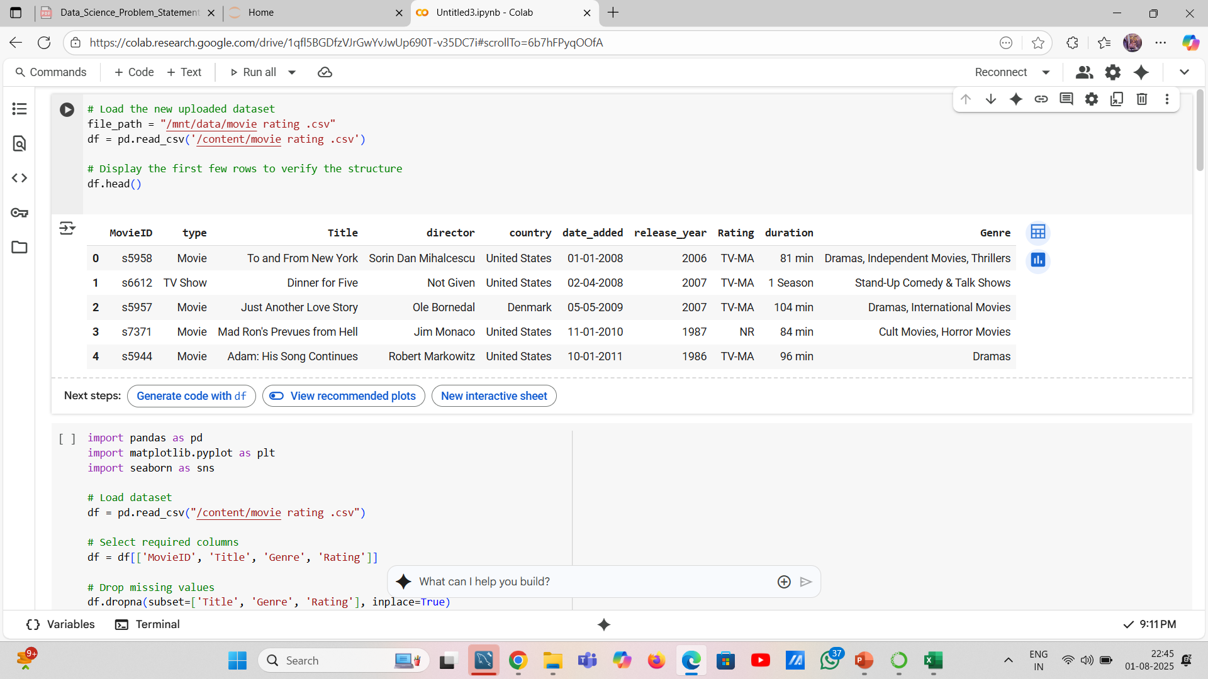
DATASET

Slide 10
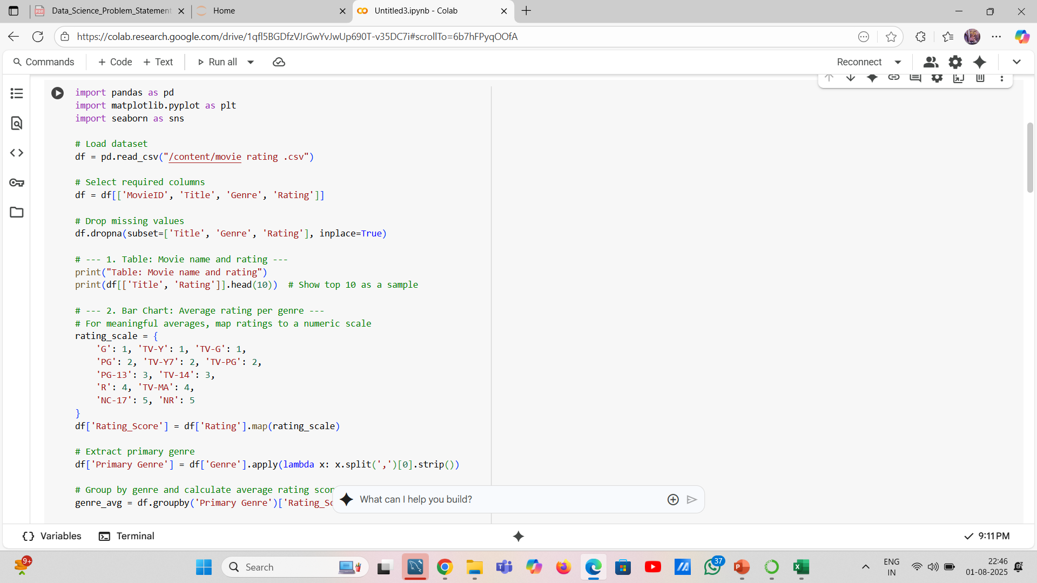
SCREENSHOT

Slide 11
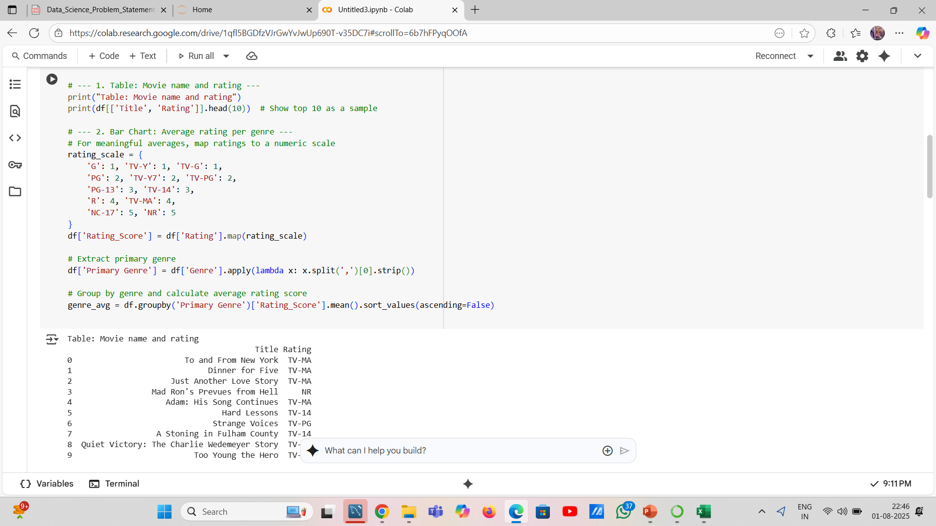
TABLE: MOVIE NAME AND RATING

Slide 12
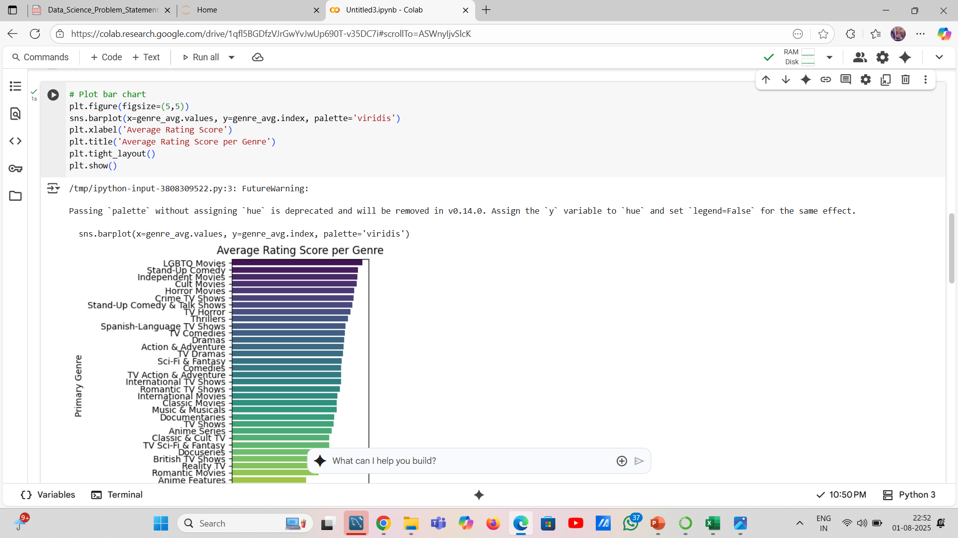
PLOT BAR CHART

Slide 13
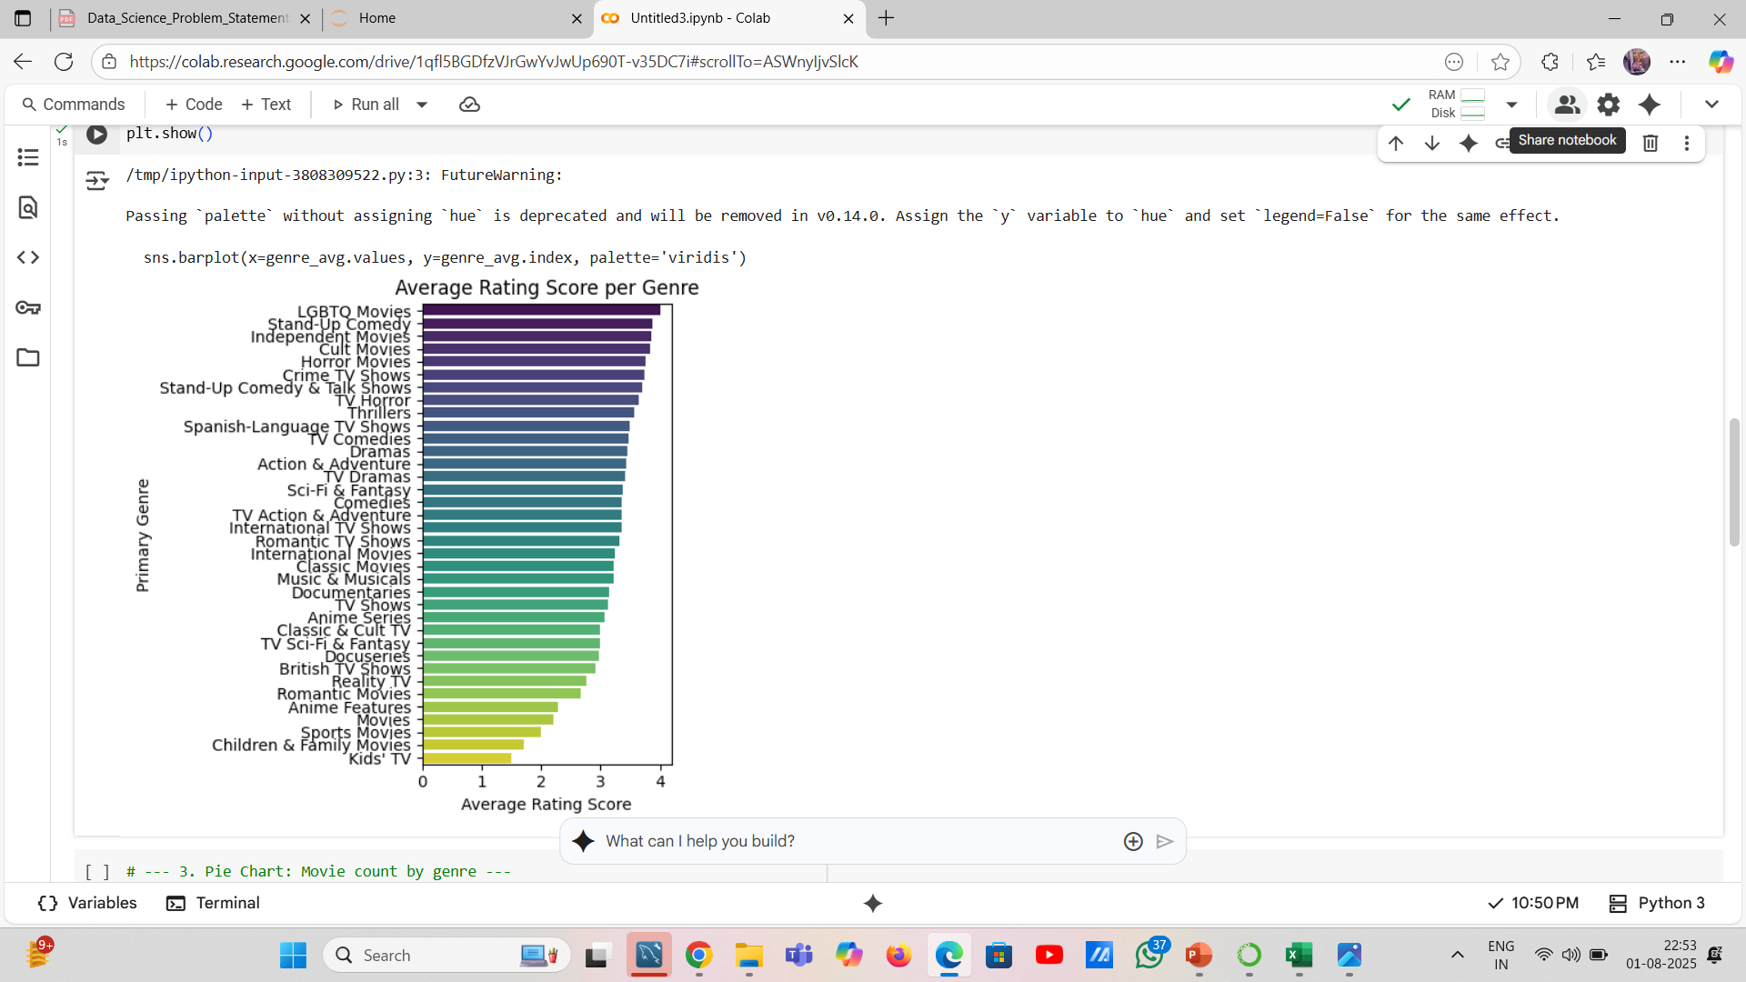
AVERAGE RATING SCORE

Slide 14
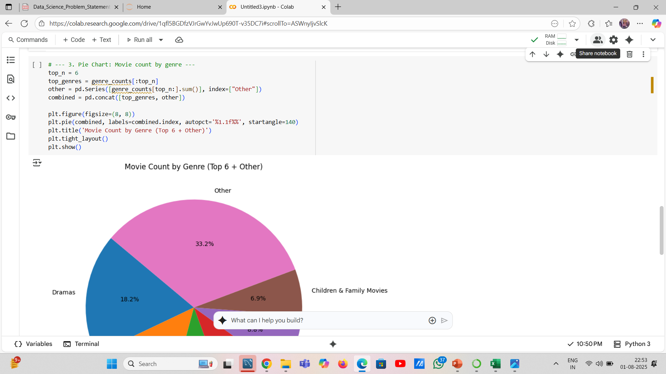
PIE CHART

Slide 15
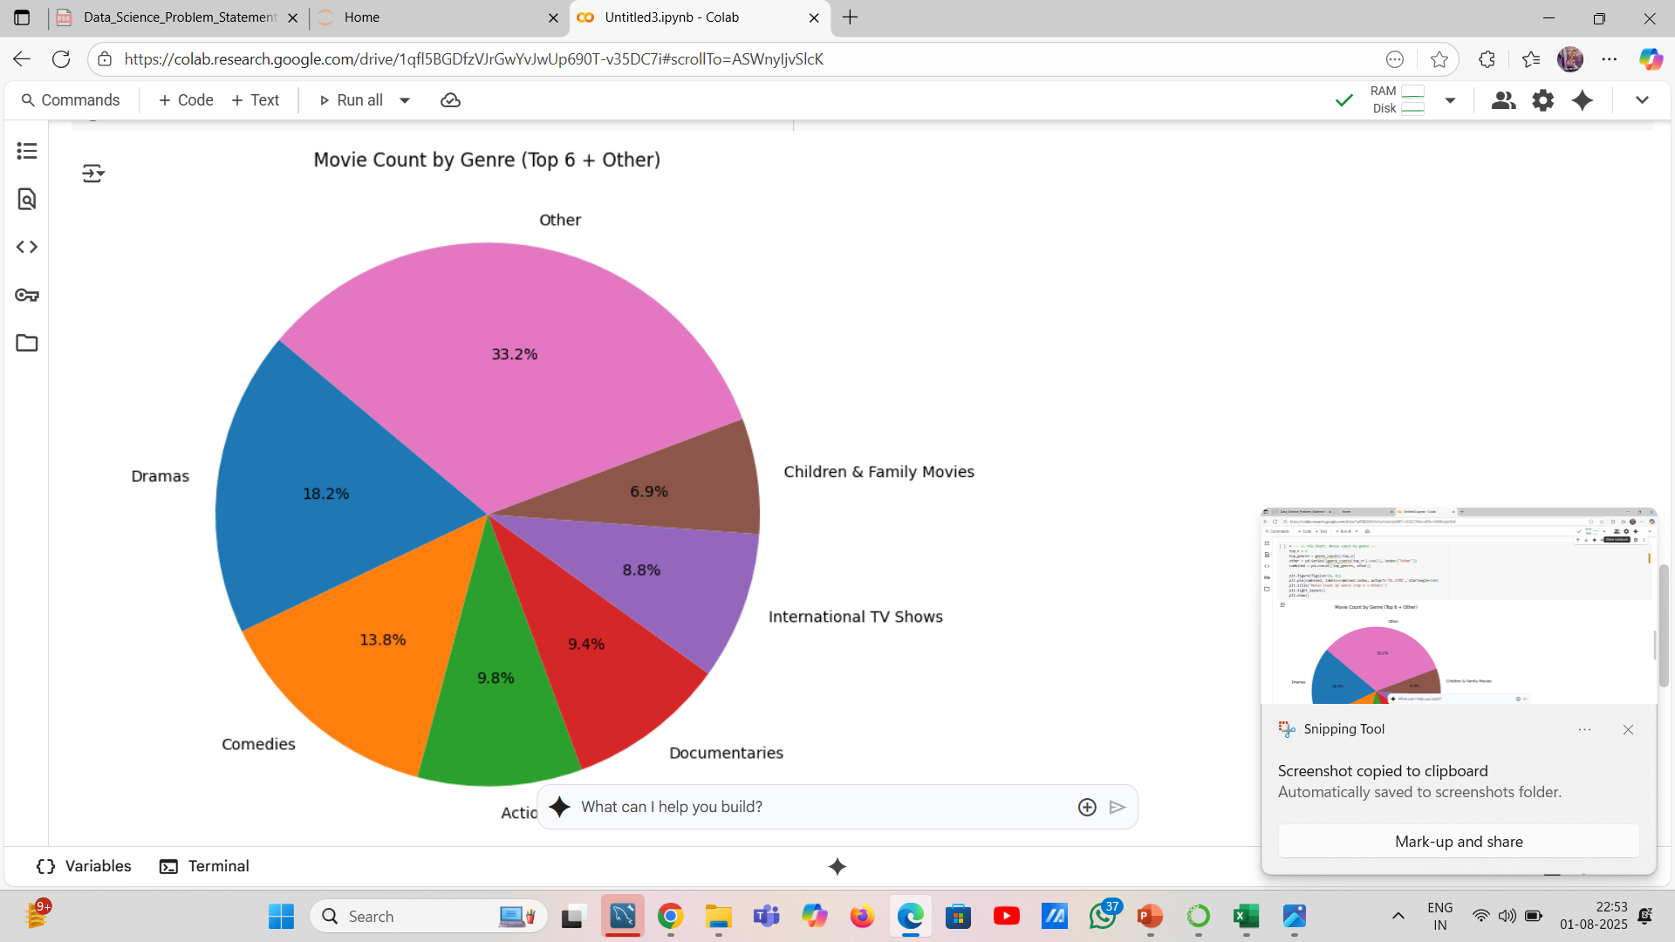
Pie Chart: Movie count by genre

Slide 16
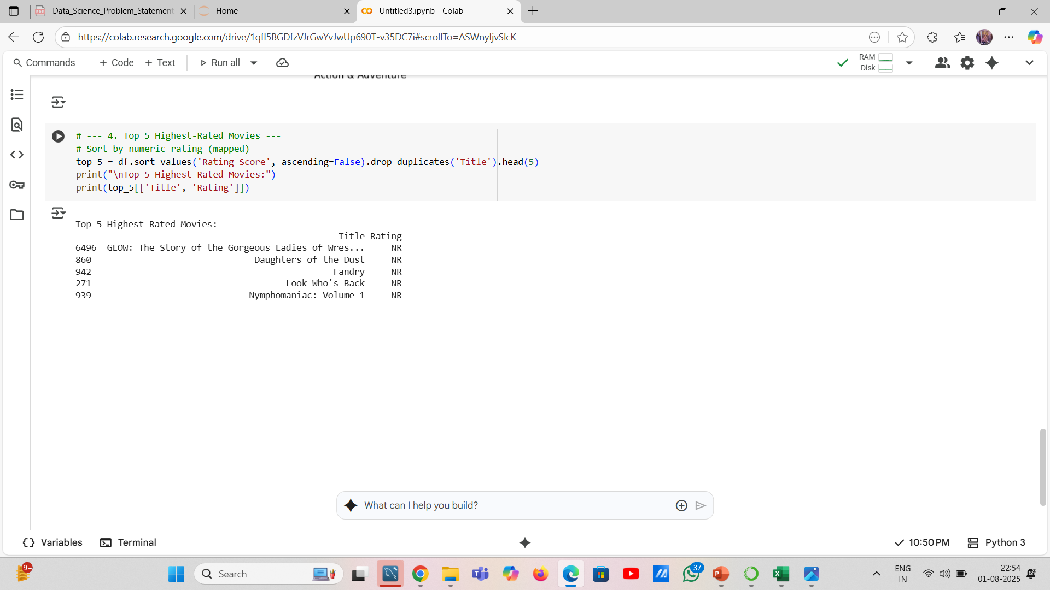
Top 5 Highest-Rated Movies

Slide 17
Thank You!

